Slide 1


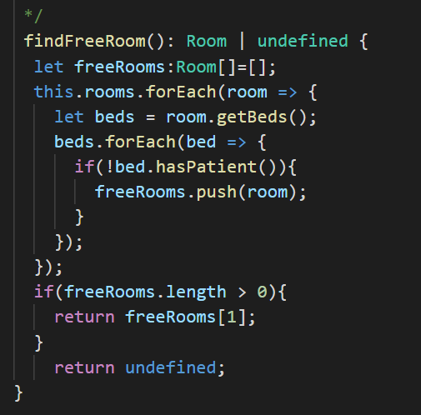
EXPLORE
Find the bugs
30 MIN
TEAM 3
Read each provided code
Also read the UML diagram to understand the objects interactions
Write down the bugs you found on each code

Slide 2
GLOBAL
Hospital
HumanManager
1
# name : string
hunans
# address : string
RoomsManager
1
rooms
CalendarManager
1
calendar

Slide 3
Human
HumanManager
Patient
<Enum>
*
Disease
Person
*
issue
CANCER
# id : number
EAR
# name : string
NOSE
# age : number
Staff
Doctor
1
# phone : number
EYES
-salary:number
specialization
*
gender
1
Nurse
<Enum>
category
1
Gender
<Enum>
StaffCategory
MALE
FEMALE
DOCTOR
NURSE
SECRETARY

Slide 4
ROOMS
RoomsManager
*
Room
- id : number
*
Bed
0/1
Patient
- id : number
patient
status
1
<Enum>
BedStatus
NEW
TO_FIX
OLD

Slide 5
CALENDAR
abstract
Event
DateTime
1
CalendarManager
# start
# day : number
*
# month : number
1
# year : number
# end
# time : number
Doctor
1
DoctorAppointement
doctor
Patient
1
patient

Slide 6
What is the mistake on this code ?
B) Find a free room

Slide 7
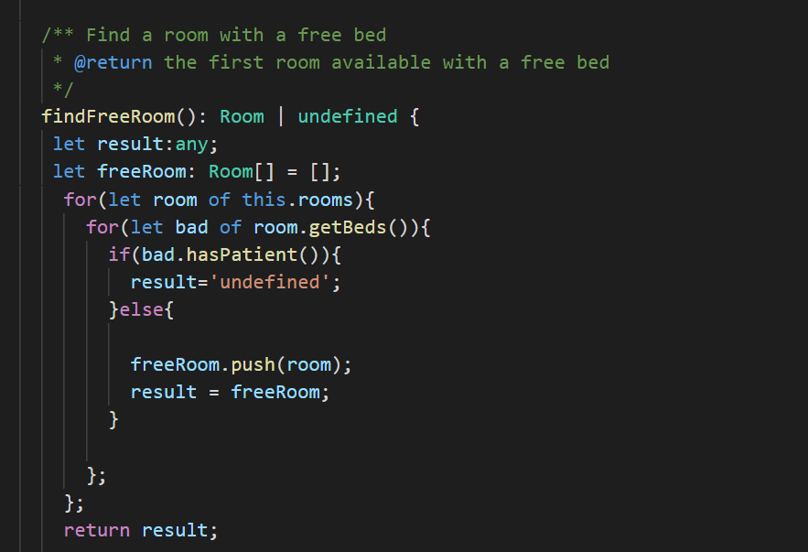
B) Find a free room
What is the mistake on this code ?

Slide 8
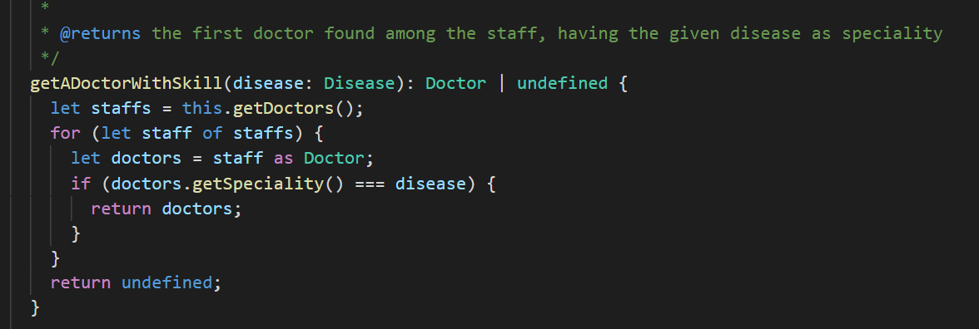
What is the mistake on this code ?
B) Find a doctor

Slide 9
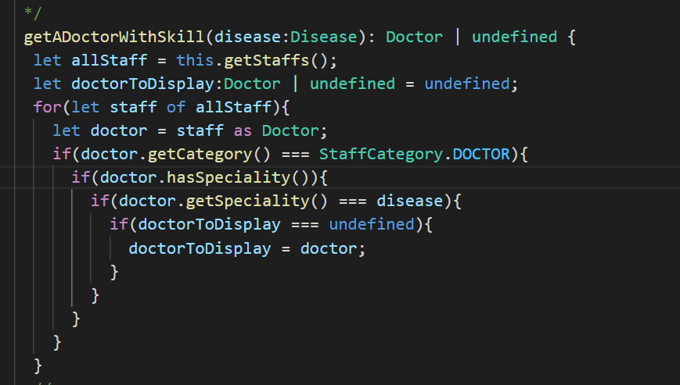
What is the mistake on this code ?
B) Find a doctor

Slide 10
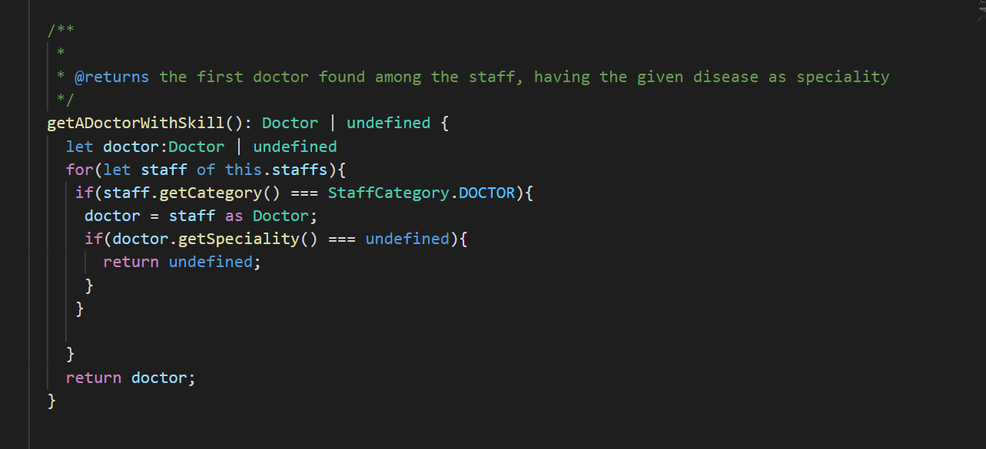
What is the mistake on this code ?
B) Find a doctor

